Slide 1
health care The charitable trust 12 A and 80 G approved charity & Child Development Centre
AWARENESS PROGRAMME to ANGANWADI WORKERS at COIMBATORE DISTRICT
Dr Mallikai Selvaraj MBBS, DCH, PGD DN
(Trained in UK)
Former member of Tamil Nadu State Commission for Protection of Child Rights
Developmental and Behavioral Pediatrician
Bhairavi Centre for Child Health and Development
www.bhairavicdc.com

Slide 2
Special thanks to our honorable Coimbatore collector Kranthi Kumar Pati & Dr Chandrasekar sir for making this happen

Slide 3
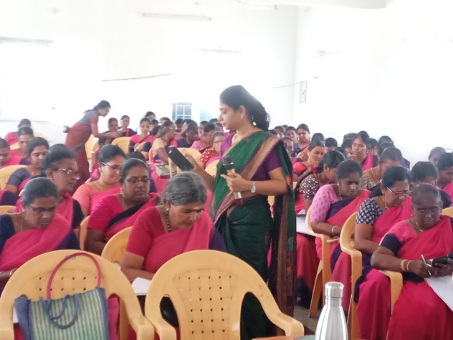
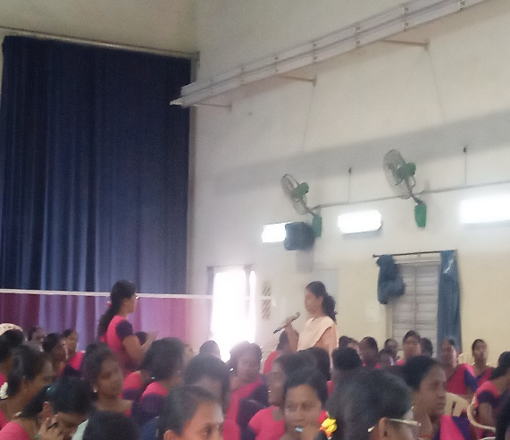
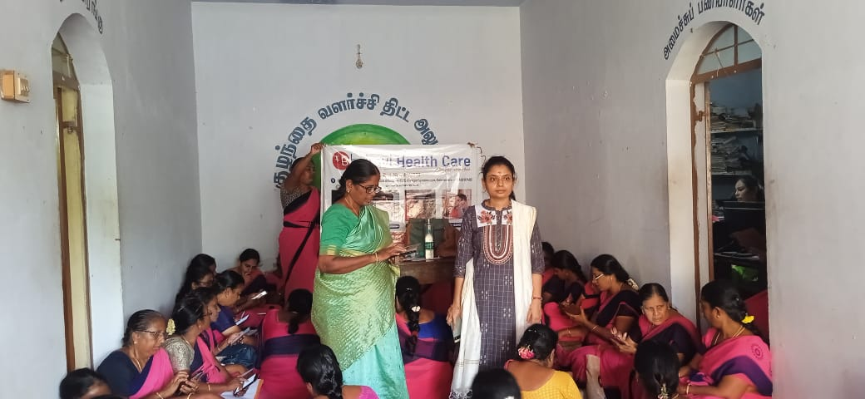
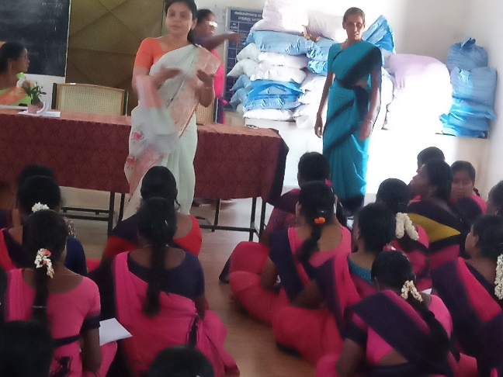
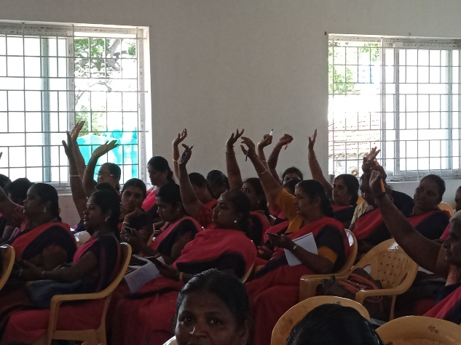
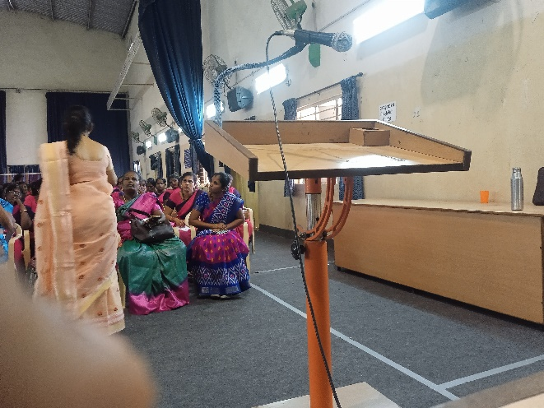
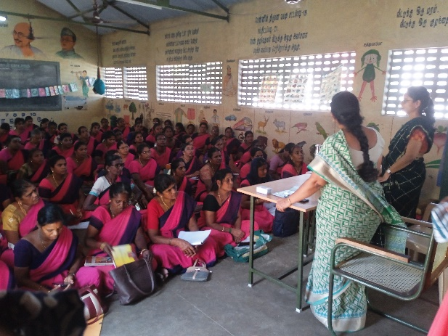
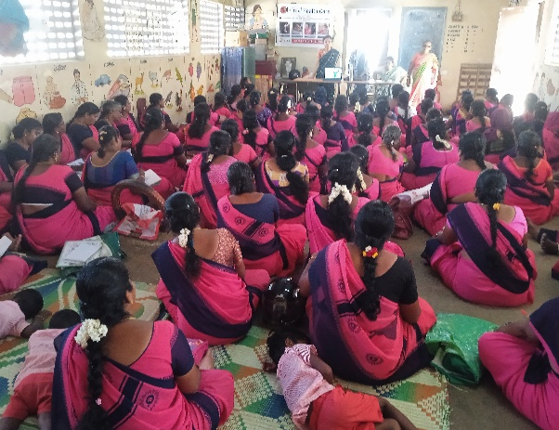
Total no of Anganwadi workers covered - 1200
Total no of blocks covered - 17

Slide 4
S.no | DATE | NAME OF AREA | NUMBER OF TEACHERS ATTENDED
1) | 17.08.2023 | PERUR | 74
2) | 17.08.2023 | SELVAPURAM | 78
3) | 25.08.2023 | SIDDAPUDUR | 115
4) |  | GANAPATHY
5) | 31.08.2023 | POLLACHI- NORTH | 142
6) | 31.08.2023 | POLLACHI- SOUTH
7) | 01.09.2023 | SARKARSAMAKULAM | 57
8) | 07.09.2023 | KARAMADAI | 120
9) | 07.09.2023 | ANNUR | 61
10) | 13.10.2023 | MATHAMPATTI | 56
11) | 13.10.2023 | PERIYANAIKENPALAYAM | 72
12) | 20.10.2023 | ONDIPUDUR | 106
13) | 20.10.2023 | SULUR | 86
14 | 02.11.2023 | MADHUKARAI | 77
15 | 30.11.2023 | KINATHUKADAVU | 49
16 | 30.11.2023 | AANAIMALAI | 56
17 | 04.12.2023 | SULTAN PETTAI | 50

Slide 5
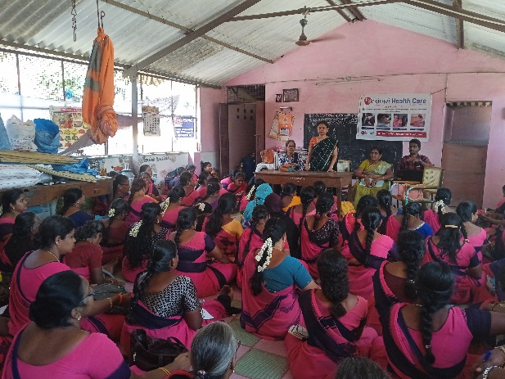
DATE : 17.08.2023 PLACE: PERUR NO OF PARTICIPANTS: 74

Slide 6
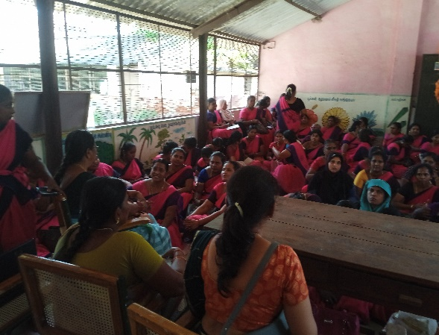
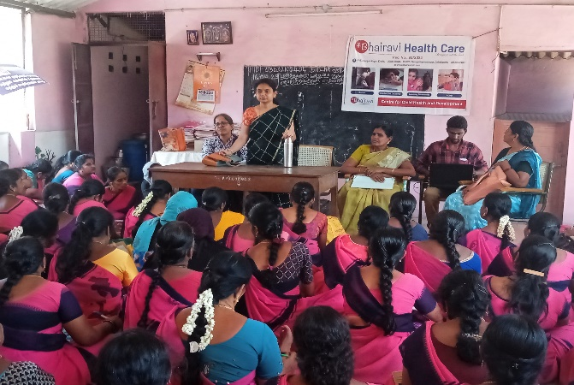
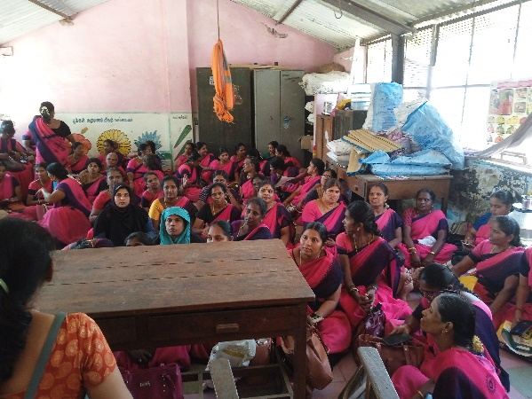
DATE : 17.08.2023 PLACE: SELVAPURAM NO OF PARTICIPANTS: 78

Slide 7
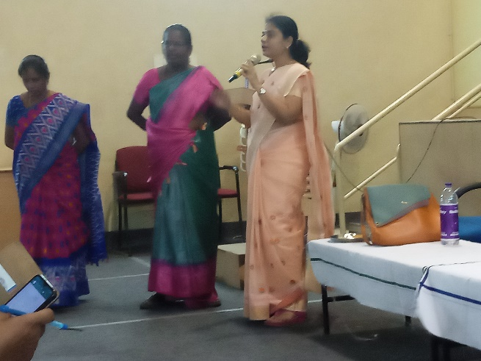
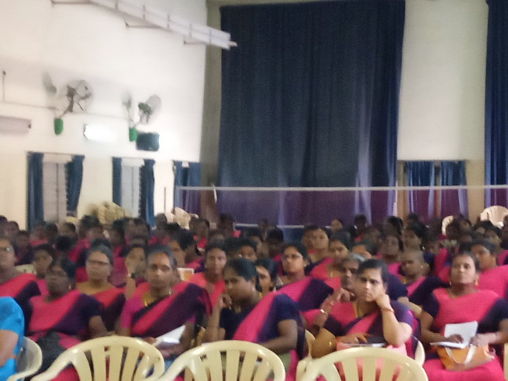
DATE : 25.08.2023 PLACE: SIDDAPUDUR NO OF PARTICIPANTS: 85

Slide 8
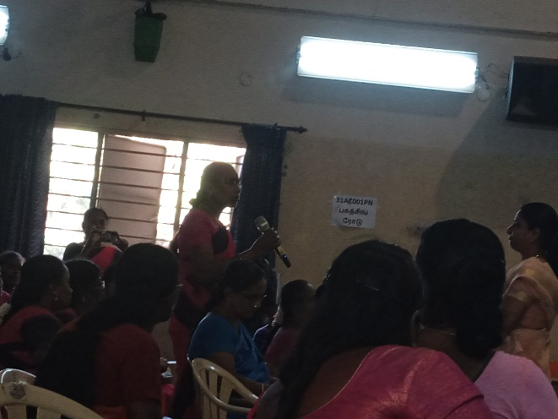
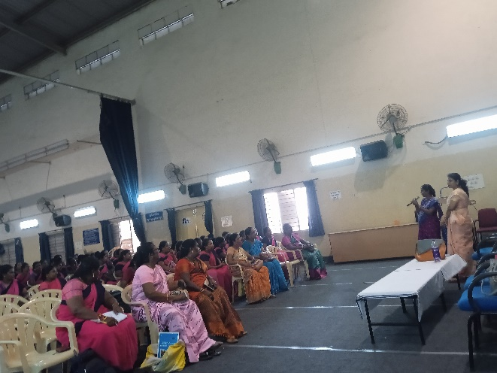
DATE : 25.08.2023 PLACE: GANAPATHY NO OF PARTICIPANTS: 30

Slide 9
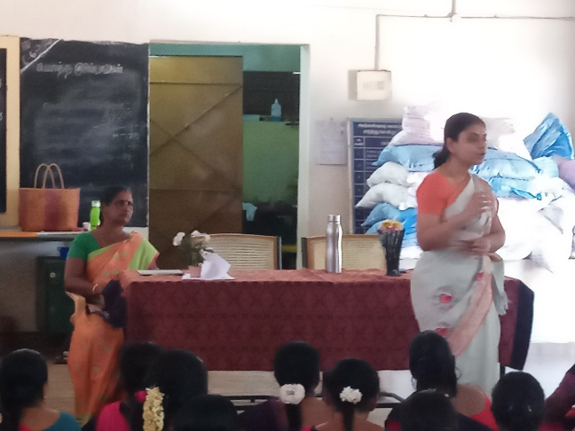
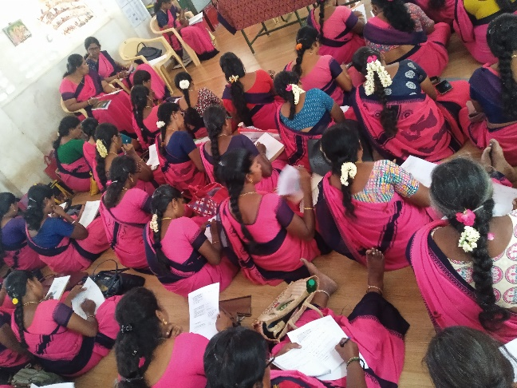
DATE : 31.08.2023 PLACE: POLLACHI (North&South) NO OF PARTICIPANTS: 142

Slide 10
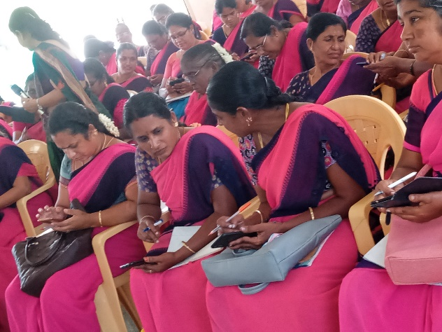
DATE : 01.09.2023 PLACE: SARKARSAMAKULAM NO OF PARTICIPANTS: 57

Slide 11
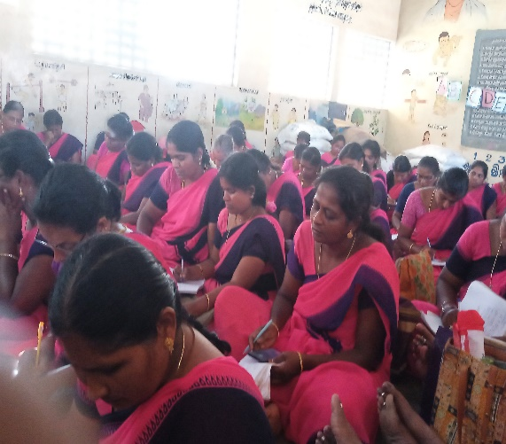
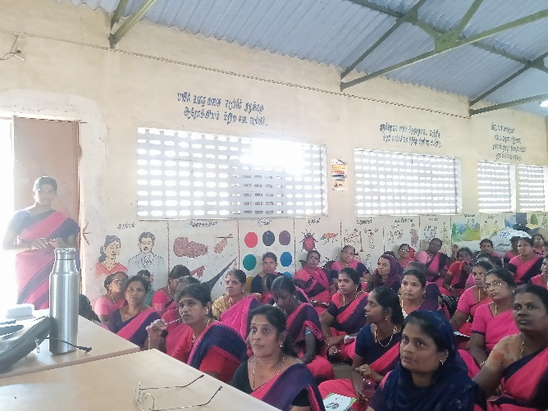
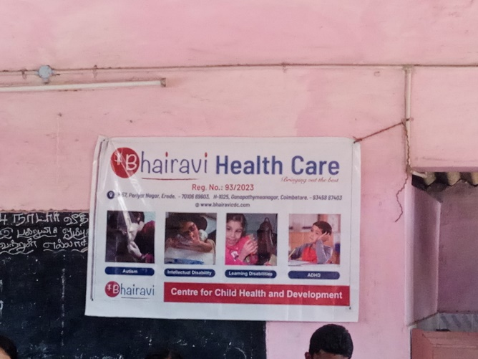
DATE : 07.09.2023 PLACE: KARAMADAI NO OF PARTICIPANTS: 120

Slide 12
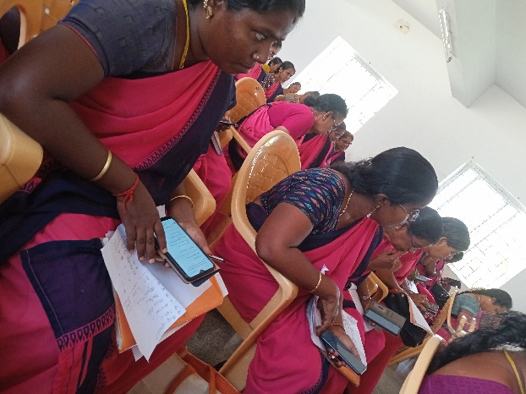
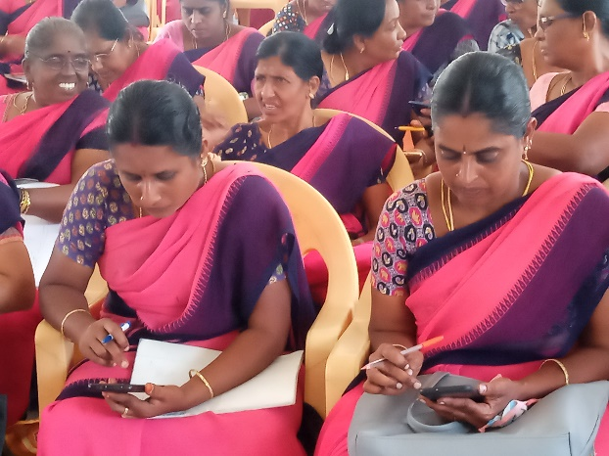
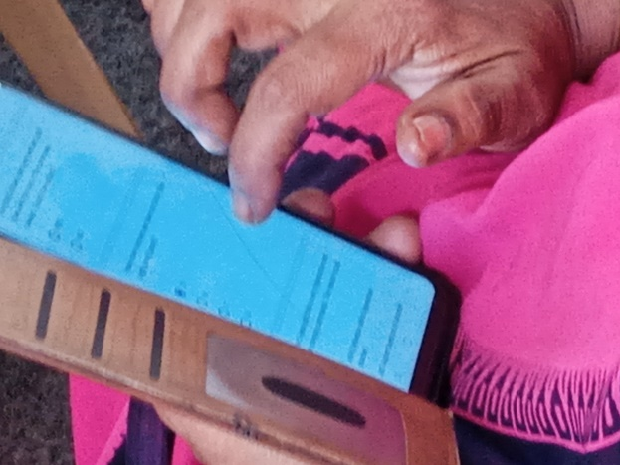
DATE : 07.09.2023 PLACE: ANNUR NO OF PARTICIPANTS: 61

Slide 13
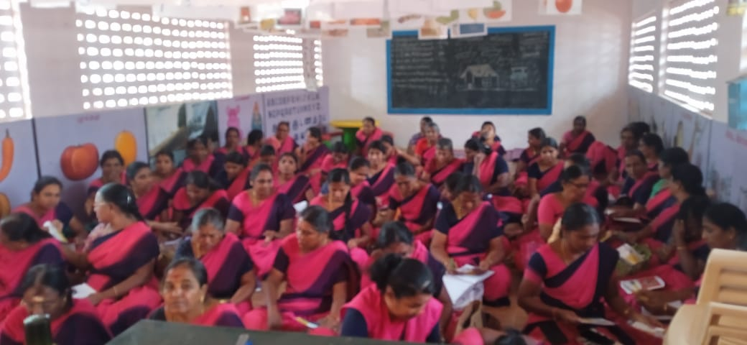
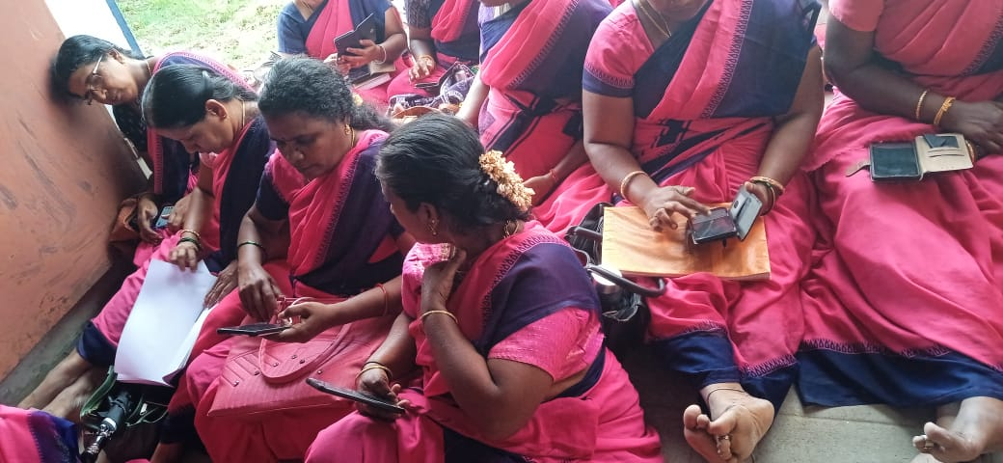
DATE : 13.10.2023 PLACE: MATHAMPATTI NO OF PARTICIPANTS: 56

Slide 14
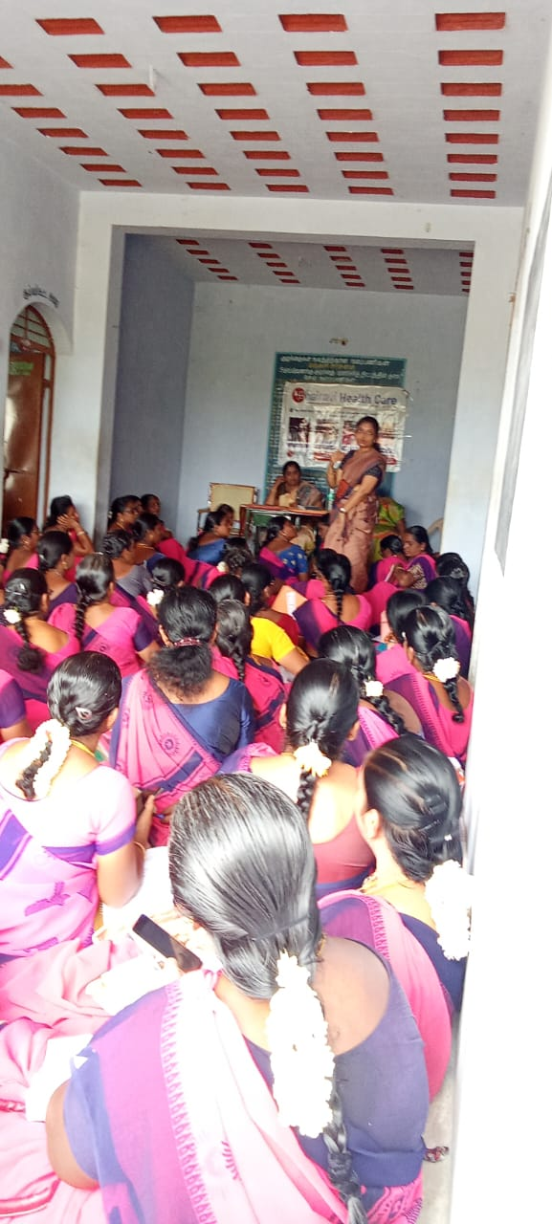
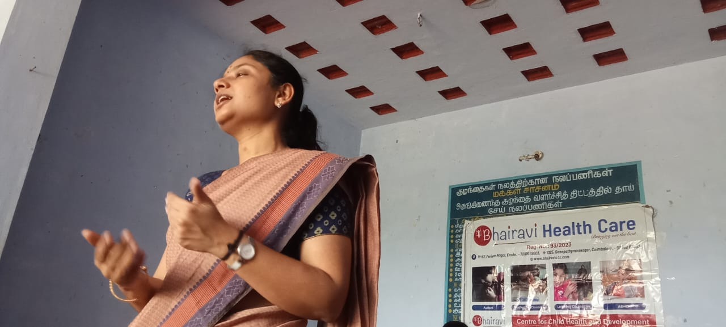
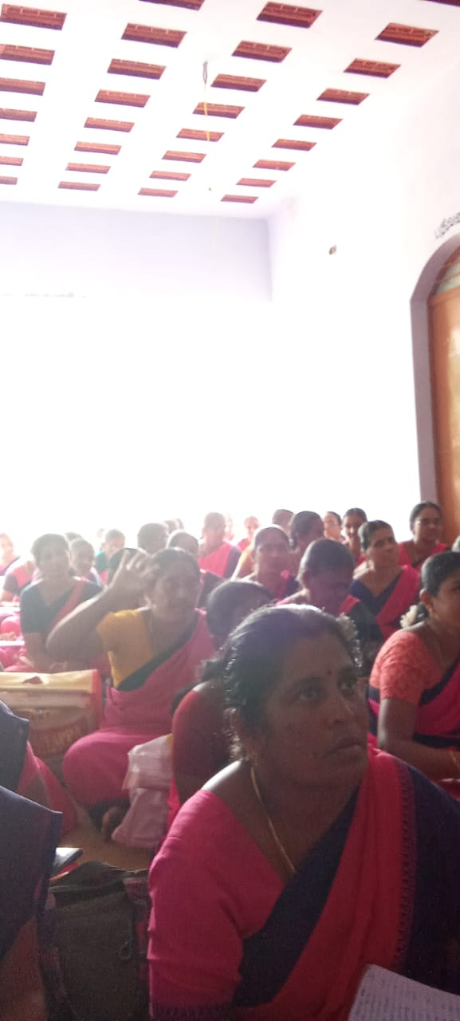
DATE : 13.10.2023 PLACE: GOUDAMPALAYAM NO OF PARTICIPANTS: 72

Slide 15
DATE : 20.10.2023 PLACE: ONDIPUDUR NO OF PARTICIPANTS: 106

Slide 16
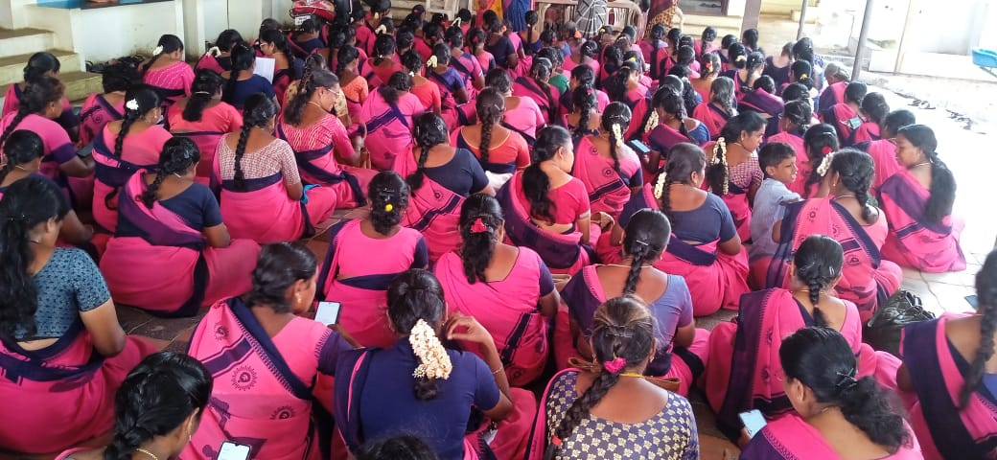
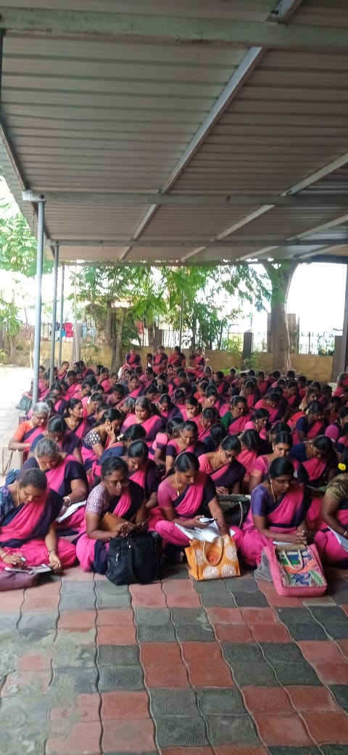
DATE : 20.10.2023 PLACE: SULUR NO OF PARTICIPANTS: 86

Slide 17
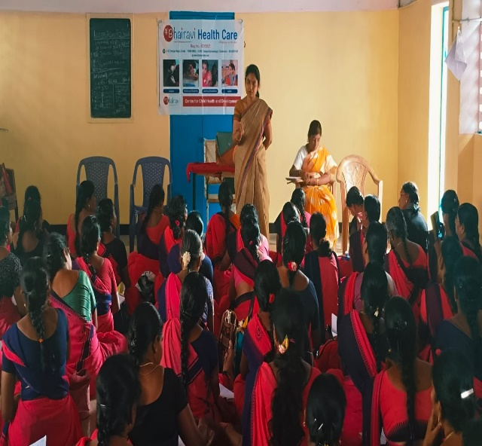
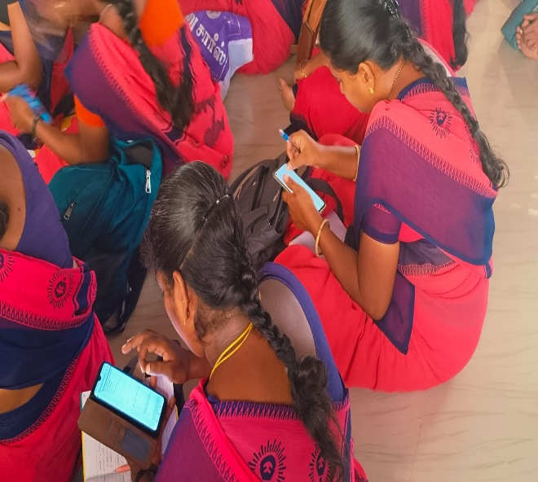
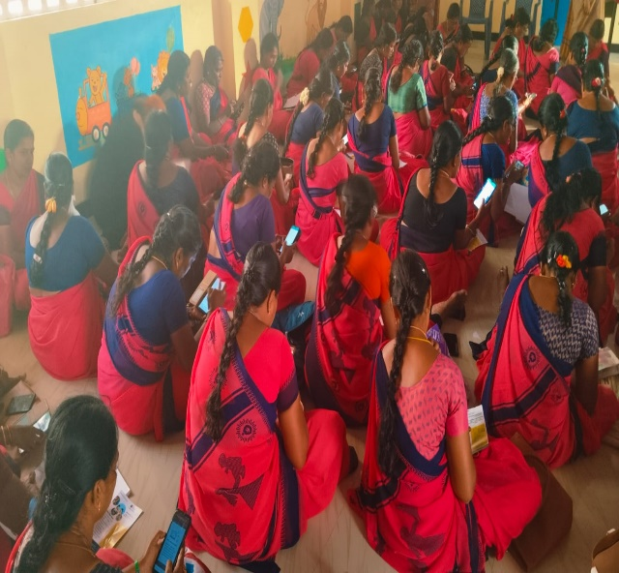
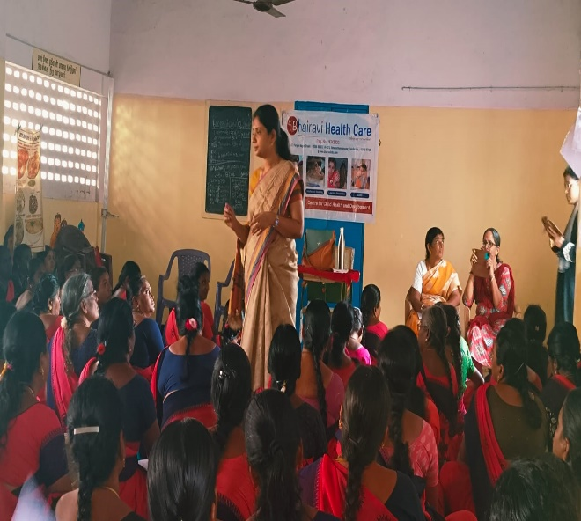
DATE : 02.11.2023 PLACE: MADHUKARAI NO OF PARTICIPANTS: 77

Slide 18
An Anganwadi teacher’s understanding
(video)

Slide 19
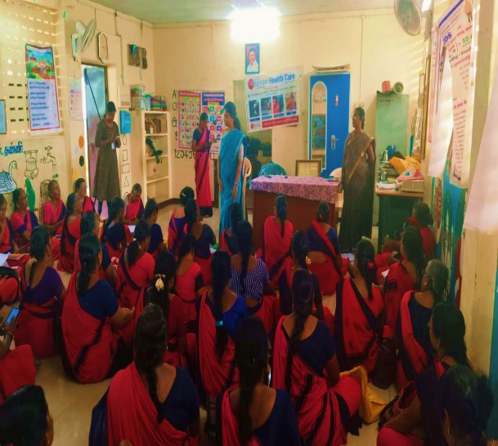
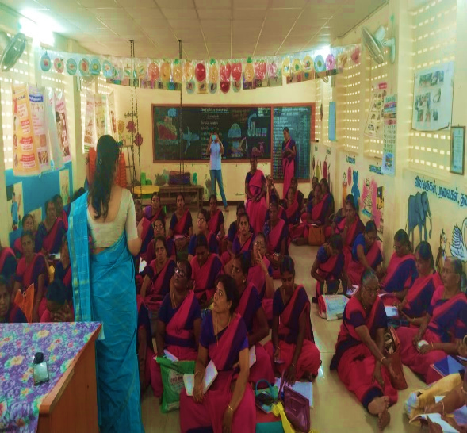
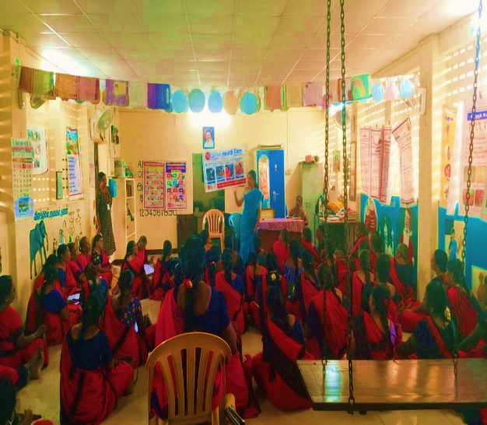
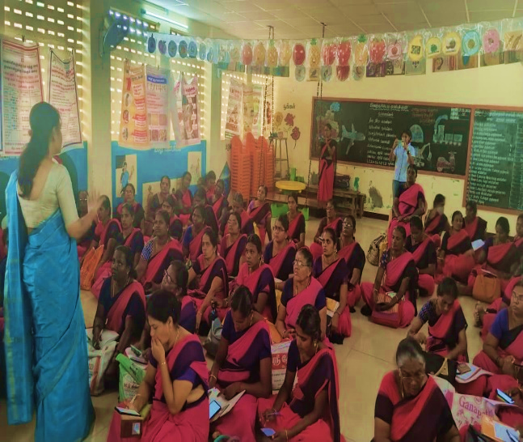
DATE : 30.11.2023 PLACE: KINATHUKADAVU NO OF PARTICIPANTS: 49

Slide 20
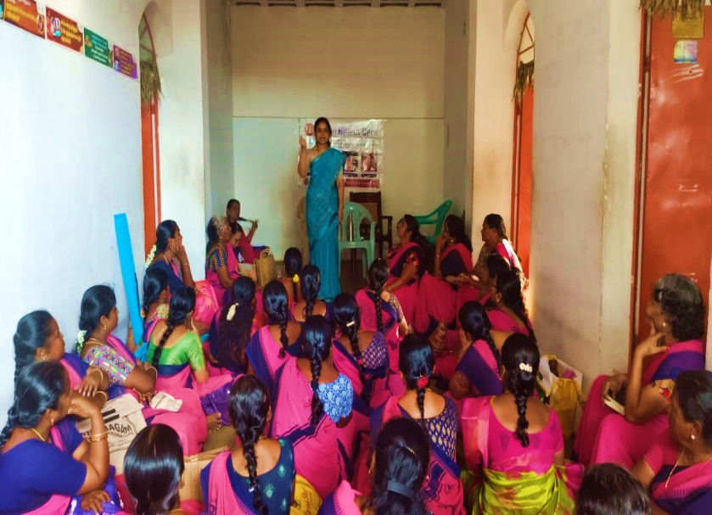
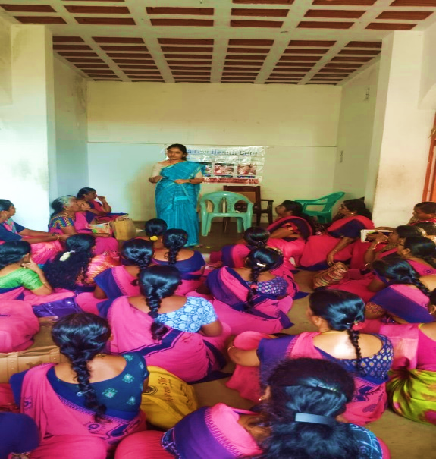
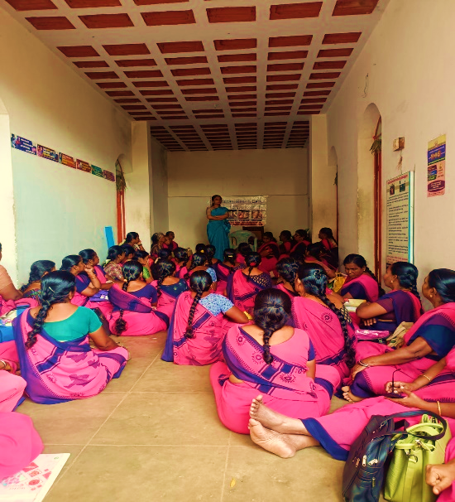
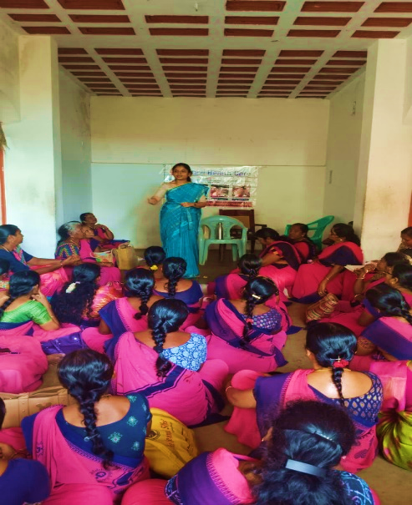
DATE : 30.11.2023 PLACE: AANAIMALAI NO OF PARTICIPANTS: 56

Slide 21
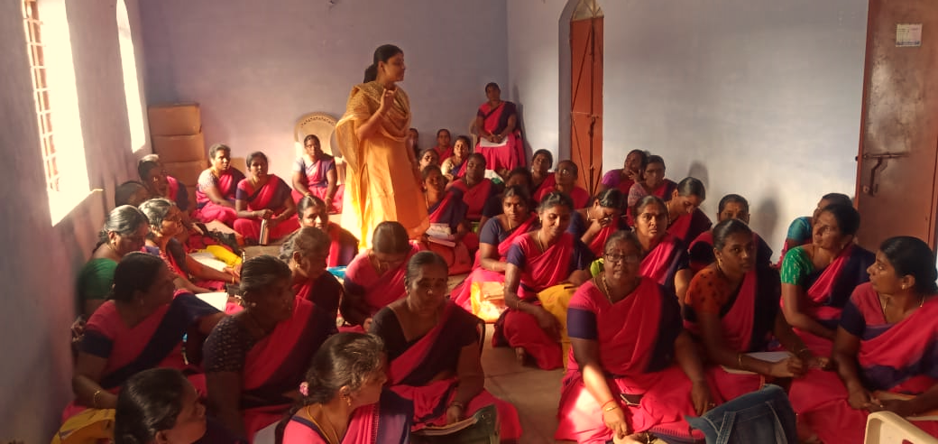
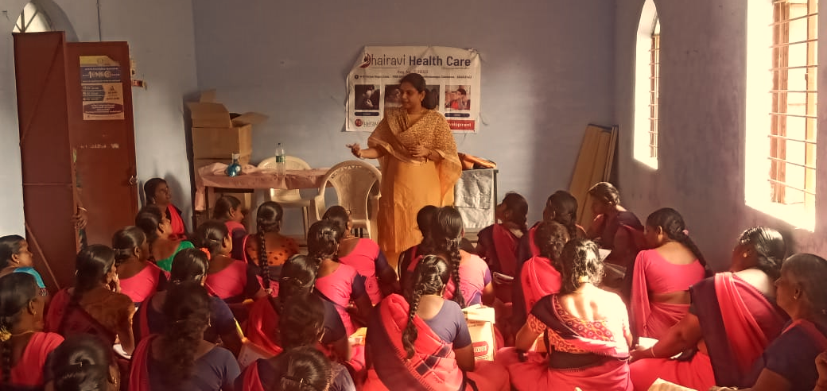
DATE : 04.12.2023 PLACE: SULTAN PETTAI NO OF PARTICIPANTS: 50

Slide 22
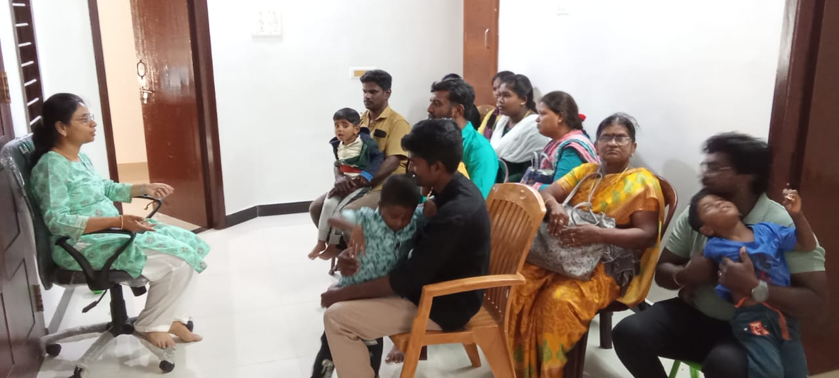
Some of the free consultations done at Bhairavi CDC every Saturday afternoon. More than 20 children were helped to get identified their developmental problems

Slide 23
PREVALENCE of ASD
About 18 million people in India are diagnosed with ASD.
Estimated to affect 1 out of every 54 children aged two to nine years are diagnosed with ASD in India.
According to CDC 1/36 has ASD in world.

Slide 24
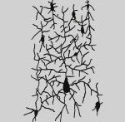
Experiences build the brain architecture
NEWBORN
100 MILLION NEURONS
50 TRILLION SYNAPSES
SYNAPSES INCREASES 20 TIMES
20 YEARS
HALF OF FIRST YEAR
FIRST BIRTHDAY
PEAK
SYNAPSES @ MOTOR & SENSORY AREA
PEAK @ 4 MONTHS STABILIZES @ 6 YEARS

Slide 25
Challenges
Lack of Awareness
Expectation that they will eventually improve on their own
A denial to accept the problems
Lack of trained professionals/resourses

Slide 26
Solution ….

Slide 27
Early Intervention at home for Parents
Give a man a fish and he will eat for a day.
Teach him how to fish and he will eat for his lifetime.

Slide 28
Early Intervention at home for Parents
As a non-profit initiative, we are preparing free online Parent skill training resource platform comprising of minimum 80 videos each of 5 minutes duration in Tamil.
It provides simplified tips and strategies to help families of children 1 - 7 years 0f age with autism and other developmental delays even before coming to a final diagnosis.
It is the combination of various strategies like Floor time, ABA, TEACCH, Sensory integration etc

Slide 29
Early Intervention at home for Parents
Training program for parents / caregivers including anganwadi and kindergarden teachers of children aged 1 to 9 years
Works on
Communication / speech
Play
Behaviour
Independence

Slide 30
Early Intervention at home for Parents
Parent child interaction is the key predictor of change.
It is not directed towards a rehabilitation model, it is towards habilitative model.
Intervention occurs continuously throughout the day
Notes:
Promotes bonding
Decreases stress level in parents
Increase parental confidence about handling their child
Helps understands infant’s cues – communication

Slide 31
Here are the ways you can make a donation. Just a small donation can help us accomplish task:
Cheque in favour of Bhairavi Health Care
Direct bank transfer to Name : Bhairavi Health Care
Account number: 42170694614
Bank Name: State Bank of India
Branch: Park branch, Coimbatore
IFSC Code: SBIN002043
3) Gpay 98940 77818

